Slide 1

DevOps - Microsoft Azure Stack Hub
Microsoft Azure Stack Hub DevOps
This work is licensed under a Creative Commons Attribution - ShareAlike 4.0 International Public License

Slide 2
Agenda
DevOps concepts and practices
DevOps on Azure Stack Hub
DevOps ecosystem
DevOps pipeline
Testing and metrics

Slide 3

What is DevOps?
“Development and Operations collaboration”
“Automation”
“Faster and smaller releases”
“A job title”

Slide 4
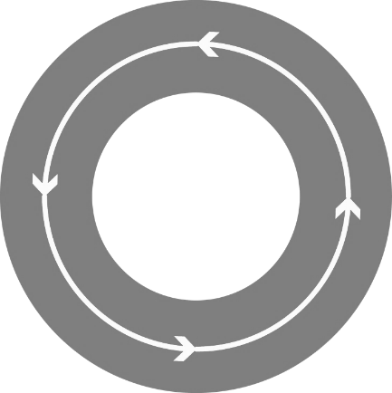
What is DevOps?
People. Process. Technology.
DevOps is the union of people, process, and technology to enable continuous delivery of value to your end users.
“
Plan & Track
Agile Planning
Dashboards
Kanban Boards
Task boards
Build & Test
Git Source Control
Modern Code Workflow
Continuous Integration
Continuous Testing
Package Management
Open Source Compliance
Develop + Test
Plan + Track
Continuous
Delivery
Monitoring & Operations
Telemetry
Diagnostics
Analysis
Compliance
Release
Deployment
Deployment of app and infrastructure
PaaS, IaaS and Containers
Monitor + Operate

Slide 5
Cloud Eases the Adoption of DevOps Practices

Slide 6
Cloud Eases the Adoption of DevOps Practices:
With self-service

Slide 7
Cloud Eases the Adoption of DevOps Practices:
With rapid deployment times

Slide 8
Cloud Eases the Adoption of DevOps Practices:
With infrastructure defined as code

Slide 9
Cloud Eases the Adoption of DevOps Practices:
With a broad ecosystem of tooling

Slide 10

Cloud eases the adoption of DevOps practices
whether it’s your cloud
or ours
Microsoft Azure Stack Hub
Microsoft Azure

Slide 11
DevOps + Azure Stack Hub: Adopting DevOps Through Cloud Transformation

Slide 12
Traditional on-premises workflow
Infrastructure defined separately from software: leads to multiple back-and-forth activities
Multiple IT-Dev handoffs yields more idle work-in-progress: longer development cycles
Deployment definition is platform-specific: limited mobility to the cloud
Testing
Dependency not found
Developers
Developers
Commit
Repository
Developers
Doc
Work Order
Rework
Doc
Staging infra
requirements
Work Order
Infrastructure
requirements
Platform #1
Platform #2
Staging
App
Prod.
App
On-premises
environment
Cloud environment
IT
IT
IT

Slide 13

DevOps with Azure and Azure Stack Hub
Application infrastructure defined as code: fewer errors
Insanely fast deployment time: software delivers more value to end users
Requirements can freely dictate Azure/Azure Stack Hub: all apps leverage a DevOps workflow
QA
App
Staging
App
Prod.
App
Azure
Azure
Software code
Repository
Azure
Infrastructure
code
Continuous Integration
OR / AND
Azure Stack Hub
Azure Stack Hub
Azure Stack Hub

Slide 14


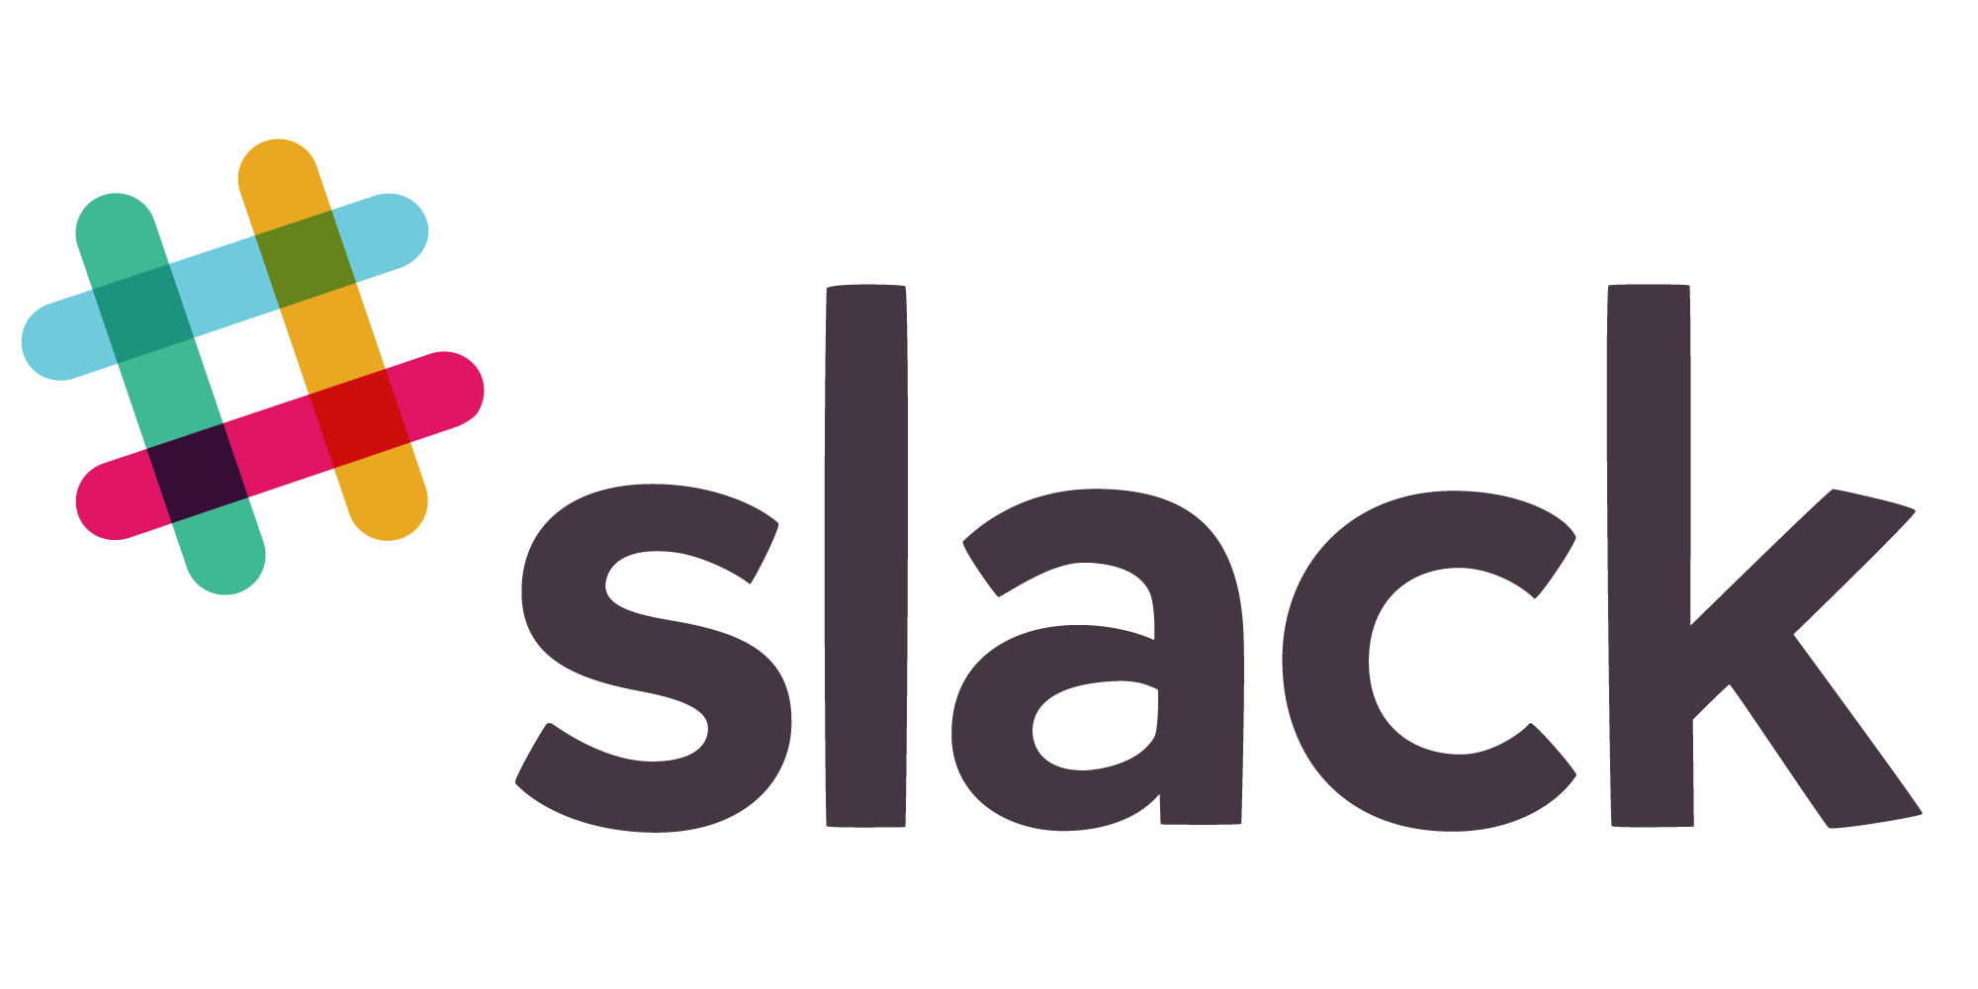
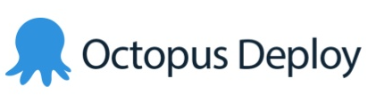































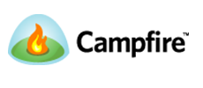
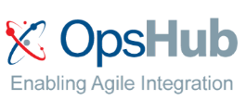


65
Visual Studio Code Extensions
90
Visual Studio Sim-Ship Partners
48
VS Team Services Extensions
What should I be using? And for what?

Slide 15
Tool categories
Test
Deploy
Environments
Monitor and Learn
BIZ
DEV
OPS
Developer Workstations
Develop
Build
Processes

Slide 16









Microsoft ecosystem
Test
Deploy
Environments
Monitor and Learn
BIZ
Microsoft Azure
DEV
Team Foundation Server
Microsoft Test Manager
ONE CONSISTENT PLATFORM
OPS
Release Management for Visual Studio
ON-PREMISES
SERVICE PROVIDER
Microsoft System Center
Application Insights
Operations Management Suite
Production / Stage
Automation Service
Developer Workstations
Develop
Build
PowerShell
MAML
Source
Team Foundation Server
xPlat CLI
Release Management for Visual Studio
Azure Resource Management
Team Foundation Server
Dev/Test
Processes
Release Management for Visual Studio
Team Foundation Server

Slide 17








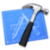





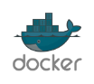


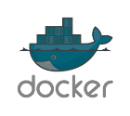

Heterogeneous ecosystem
Test
Deploy
Environments
Monitor and Learn
BIZ
Microsoft Azure
DEV
ONE CONSISTENT PLATFORM
Chef
Puppet Labs
ON-PREMISES
SERVICE PROVIDER
OPS
Hudson
Zabbix
Developer Workstations
Develop
Build
Saltstack
Source
Vagrant
GitHub
Codeplex
Grunt
Gradle
Vagrant
Dev / Test
Processes

Slide 18
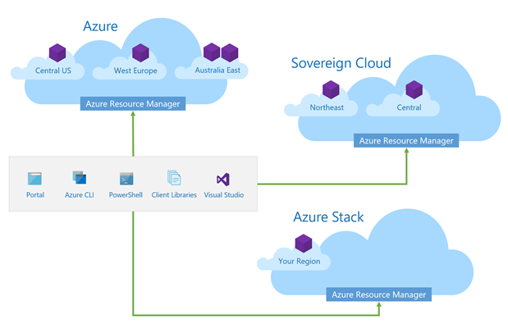
Consistent application development
Build and deploy apps the same way, for any Azure Cloud
Implement Common DevOps Practices
Use the same tools across Azure Clouds

Slide 19
Consistent
Application Development
Service
Consistency
Tooling
Consistency

Slide 20
Service Consistency
Across All Azure Clouds

Slide 21


Deploy repeatedly & reliably using ARM
Describe
Deploy
Control
Azure Resource Manager & DevOps Tool Integrations
Infrastructure as Code built-in with Azure Resource Manager
Consistent between Azure and Azure Stack Hub
Support for DevOps tools integrations and OSS tooling
Azure Resource Manager
Azure Resource Manager
Azure Stack Hub
Azure

Slide 22

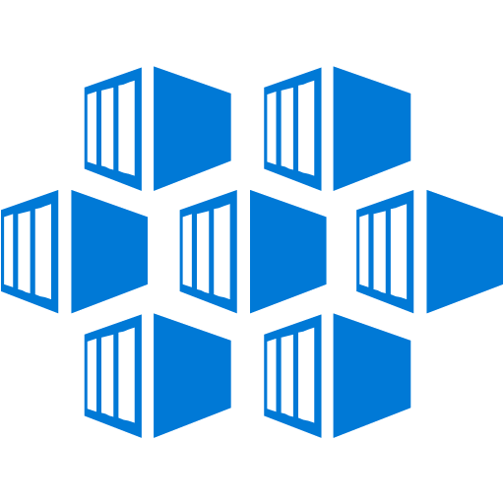


A consistent cloud platform
Tools
Experiences
Deployments
App development and operations
Application Patterns
Automations
Operations
Serverless
App Service
Containers
Marketplace
Azure services
Virtual machines
Networking
Storage
Key Vault
Azure
Consistency
Azure
Stack

Slide 23
Tooling Consistency
across all Azure Clouds

Slide 24
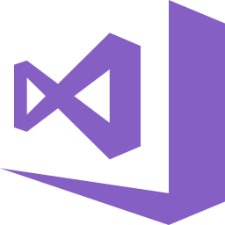

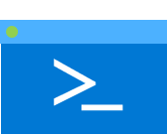




Develop
Visual Studio Tools
Visual Studio Cloud Explorer
Azure Tools
Deploy and Manage
Trusted
Consistent Tooling across clouds
Productive
Intelligent
Hybrid
Azure CLI
Azure SDKs (.Net, Java etc…)
Azure PowerShell
Azure Storage Explorer
Monitor
Log Analytics
Application Insights

Slide 25









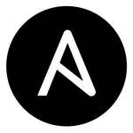


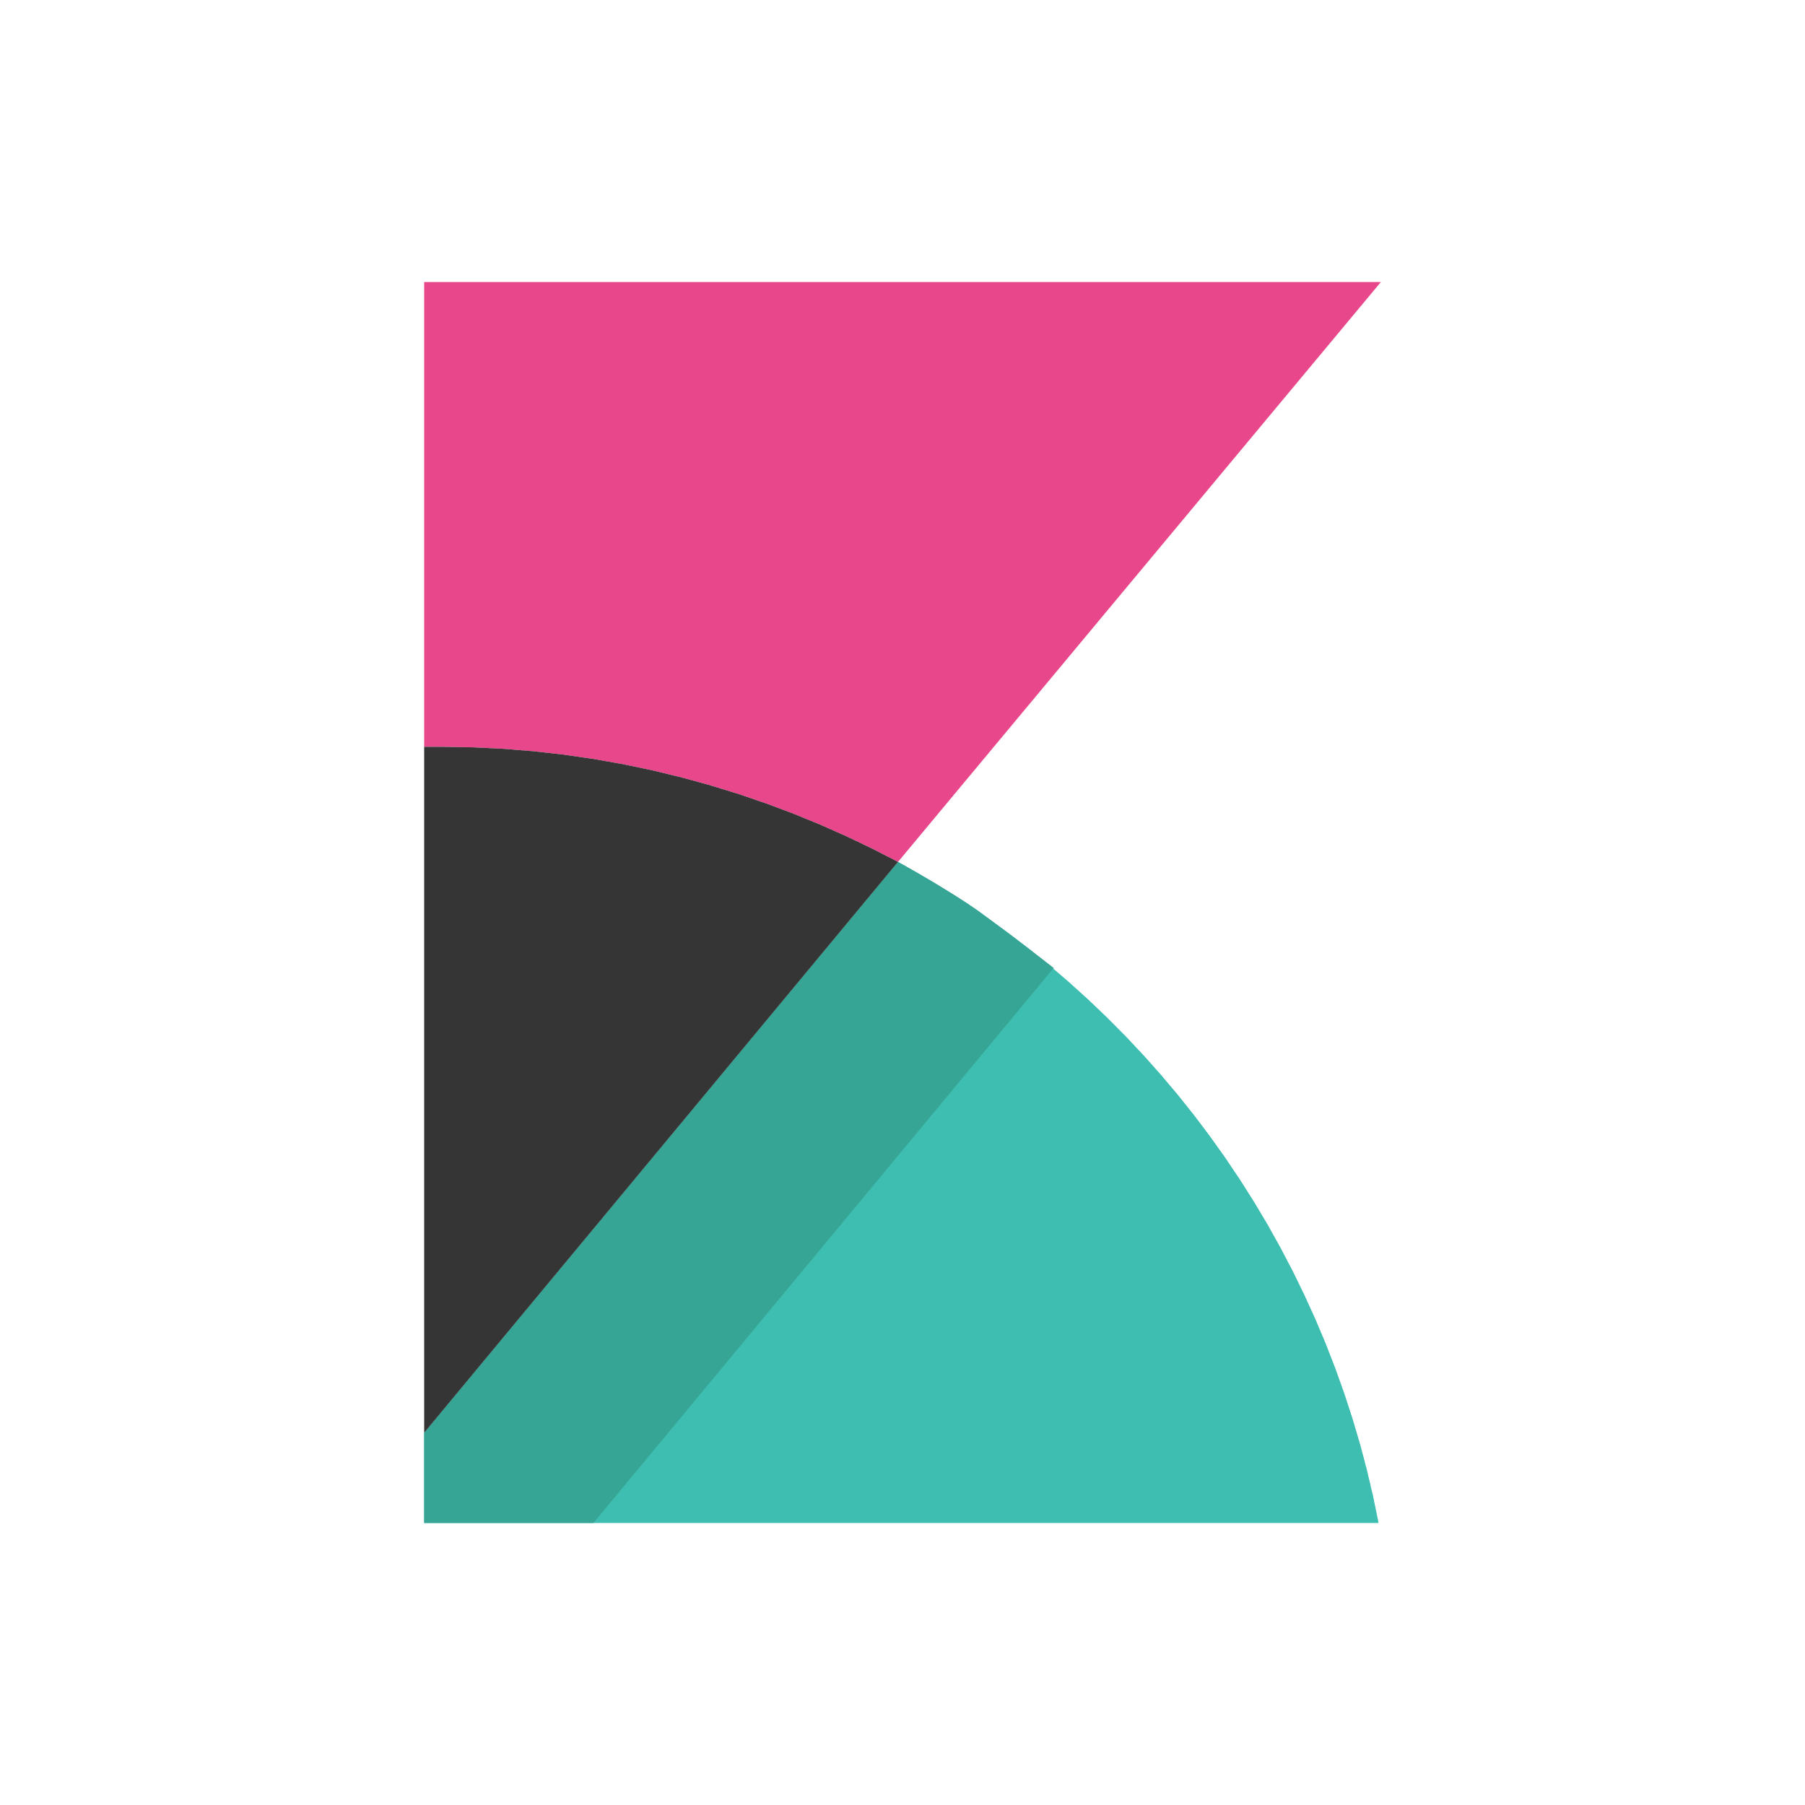
Azure DevOps framework
Maybe you use this set of tools…
Plan and track
Code
Build and test
Deploy
Operate
Monitor
Azure Boards
Azure Repos
Azure Pipelines
Azure Pipelines
Key Vault
Application
Insights
Trello
GitHub
Jenkins
Terraform
Ansible
ELK Stack
…or maybe these ones…
…or maybe a combination!

Slide 26
Hybrid DevOps pipeline - architecture

Slide 27
Hybrid DevOps Pipeline - Architecture
Code
Use Visual Studio or Visual Studio Code
Synchronize Repositories to Dev env
Define Infra for app using ARM templates
Maintain code for Application separately

Slide 28
Hybrid DevOps Pipeline - Architecture
Build
Build Agent hosted in Azure
Set up for Continuous Integration

Slide 29
Hybrid DevOps Pipeline - Architecture
Release to Azure
Create/Update Web App Infra on App Svcs through ARM template on Azure
Publish code to Web App

Slide 30
Hybrid DevOps Pipeline - Architecture
Release to Azure Stack Hub
Release Agent hosted on-prem
Release Agent has access to Azure Stack Hub
Create/Update Web App Infra on App Svcs through ARM template on Azure Stack Hub
Publish code to Web App

Slide 31
Hybrid DevOps Pipeline - Architecture
Monitor Applications
Use Application Insights in Azure to monitor resources in Azure and Azure Stack Hub

Slide 32
Service considerations between Azure clouds
Azure Stack Hub services will lag a little behind their Azure counterparts
API versions are different across different Azure clouds
You can use API profiles to abstract away the different levels of API between Azure and Azure Stack Hub. More in the hybrid cloud module coming up later…
Our Goals:
Closing the service version gap between Azure and Azure Stack Hub
Unified Programming models to account for different versions

Slide 33
Tooling Considerations
Between Azure Clouds

Slide 34
Considerations for tools to enable hybrid applications
No hardcoded endpoints
AAD vs AD FS support
No strict coupling to Azure API versions
https://aka.ms/consistency

Slide 35
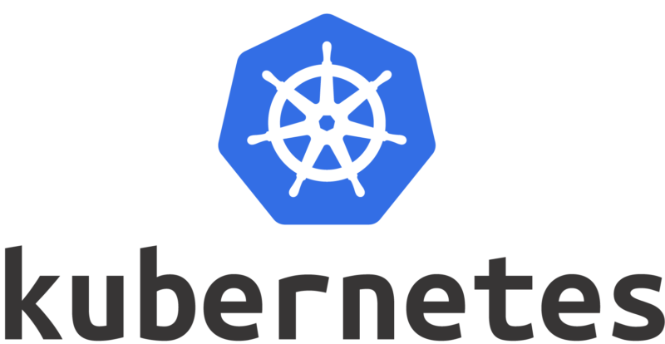
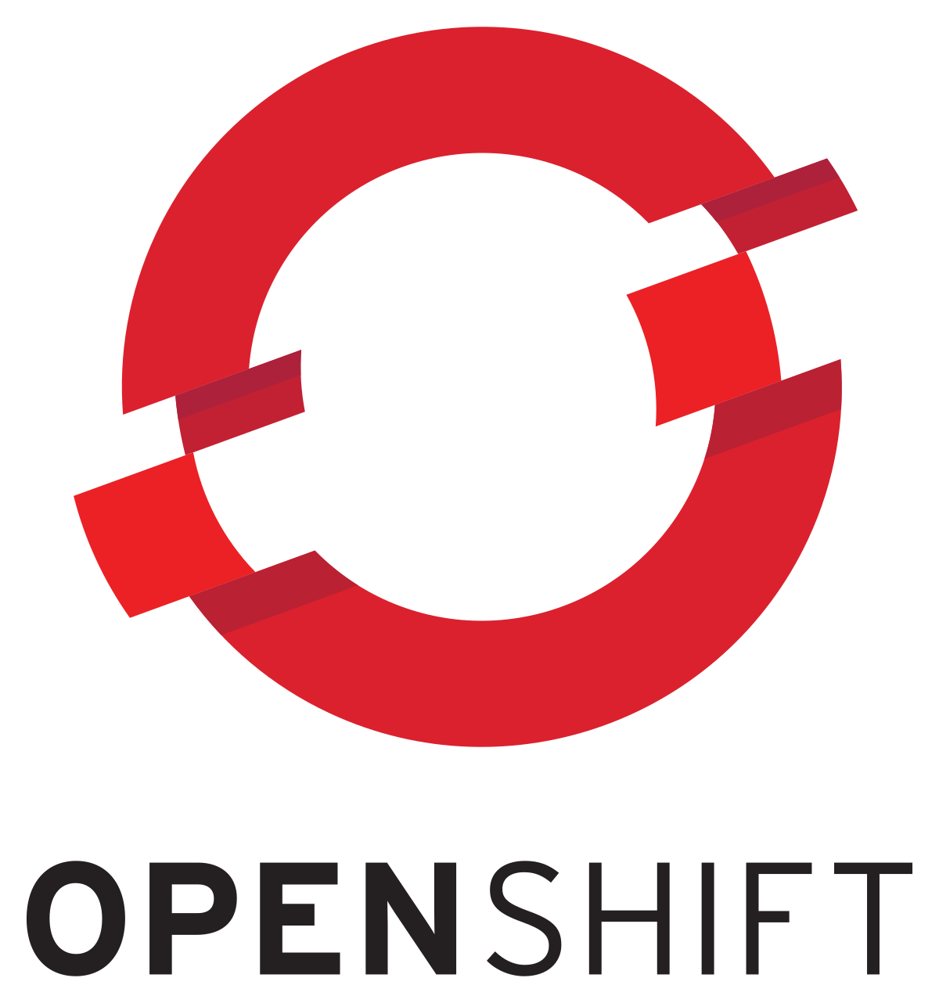
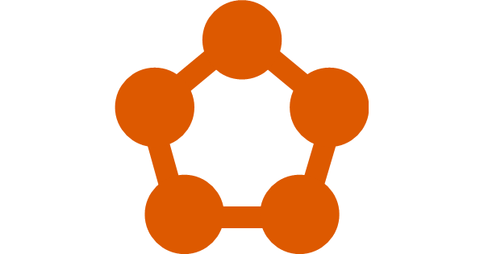
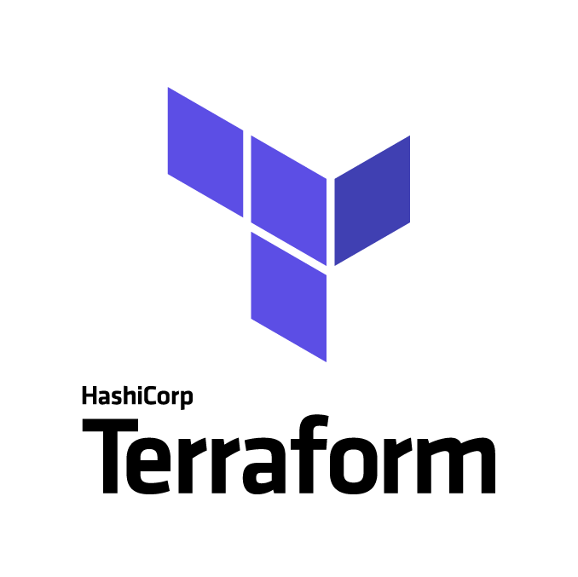
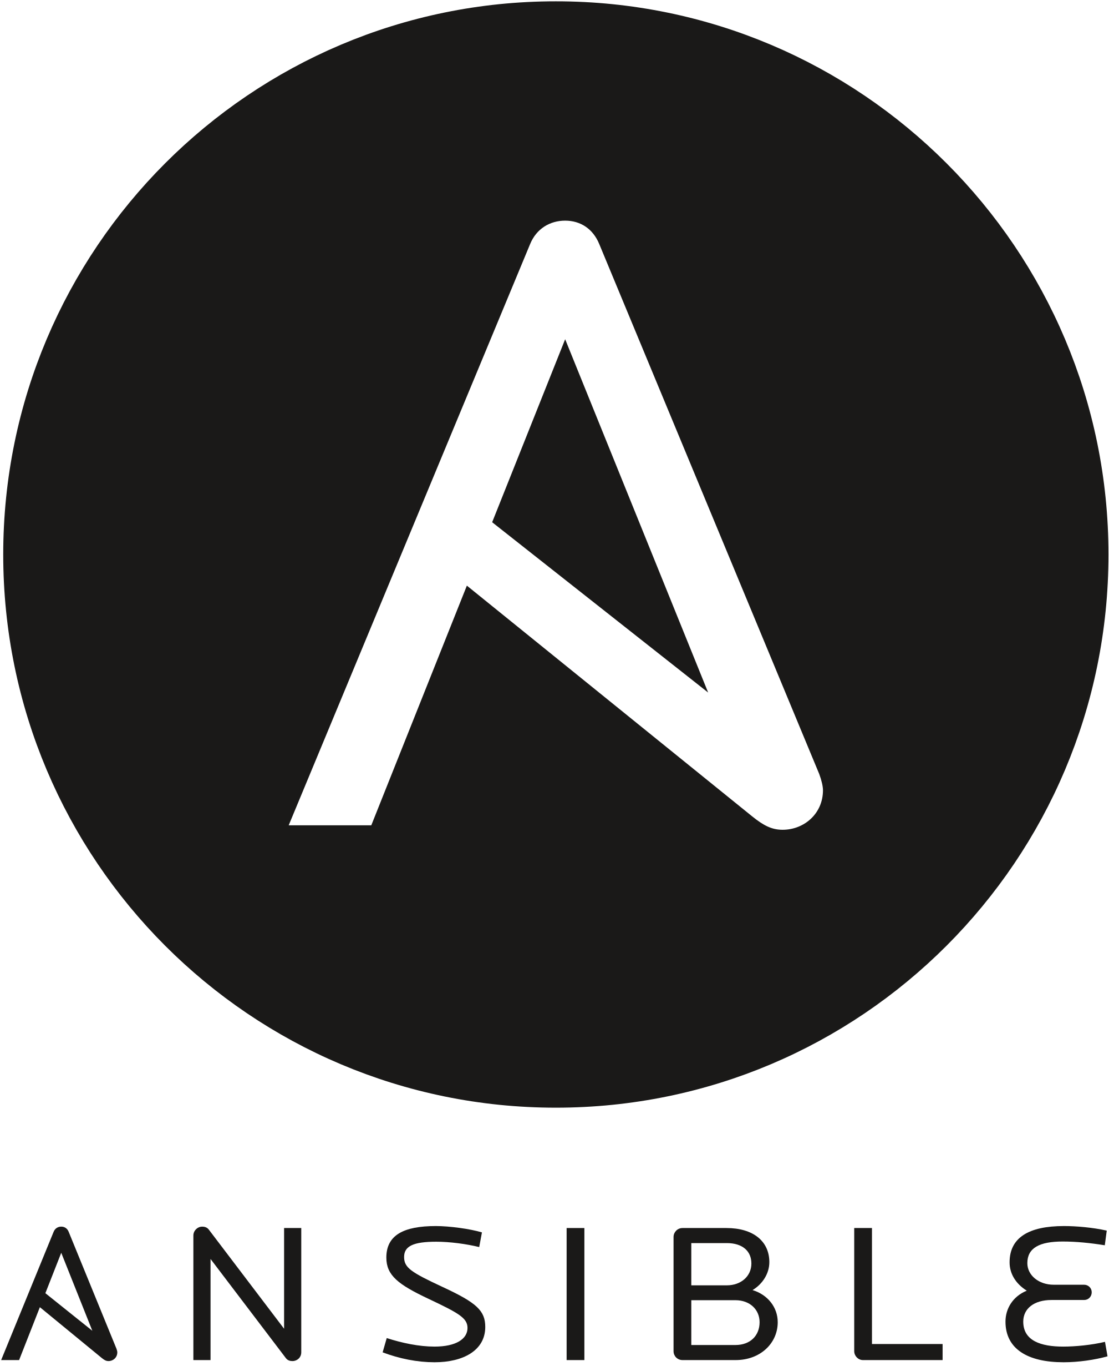
Support from more tools coming soon…
Tools available today
Azure Service Fabric

Slide 36
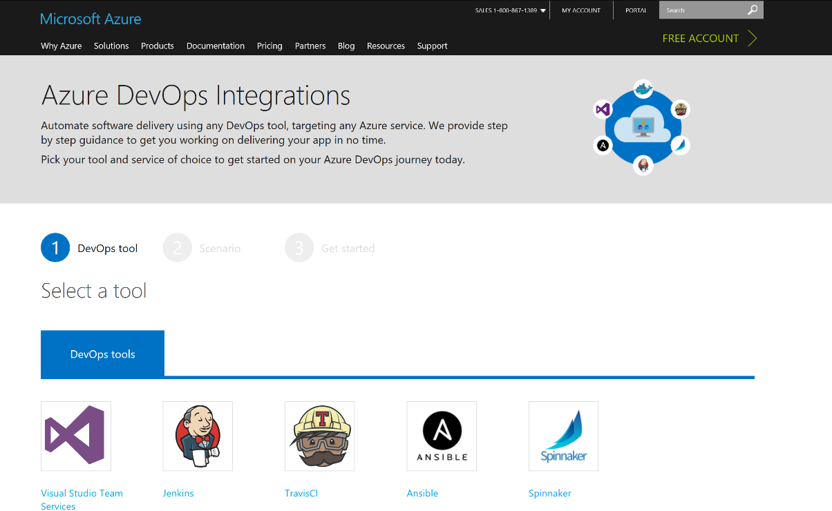
Getting started with DevOps in Azure
http://aka.ms/trydevops

Slide 37
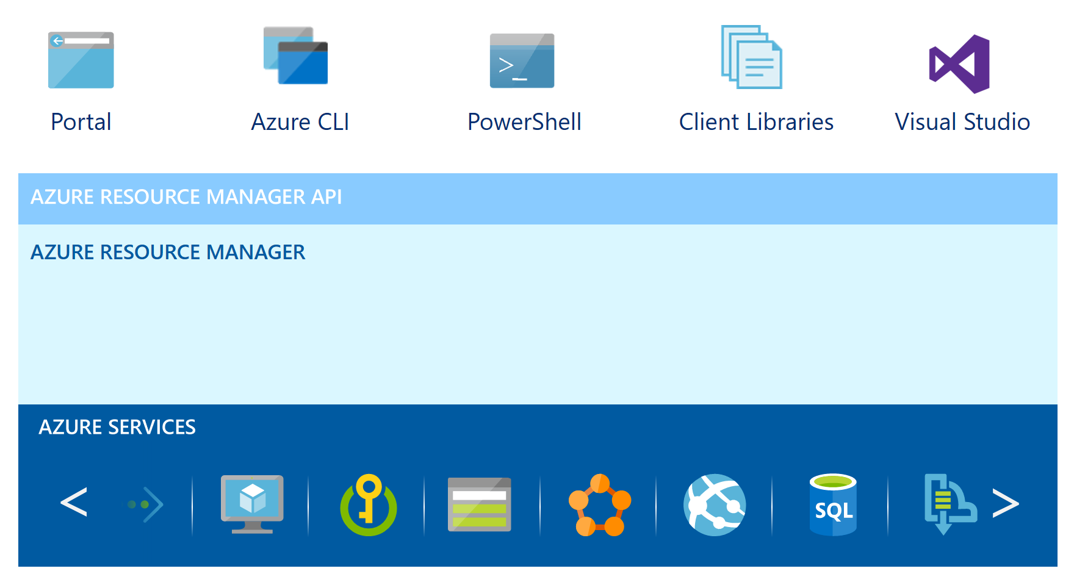
Getting started with Azure Resource Manager
http://aka.ms/GettingStartedWithARM

Slide 38

Start your journey in Azure
Will your Azure solution work on Azure Stack Hub?
2 tools you can get from the Azure Stack Hub Tool repository on GitHub:
Azure Resource Manager Template Validator for Azure Stack Hub
Azure Resource Manager Policy for Azure Stack Hub
Guardrails to check your ARM template for resource dependencies that may not be available on Azure Stack Hub
Download the tool: https://github.com/Azure/AzureStack-Tools

Slide 39
Questions?

Slide 41
Appendix

Slide 42
Imagine IT as a profit platform, not a cost center
IT would be opening up new lines of business to meet customer demand
There would be a stronger focus on applications
IT would drive the business with experimentation to deliver customer value

Slide 43





The consequences of inefficiency
1
%
Developers
IT Ops
Business
3/4
of teams
The average hourly cost of infrastructure failure is $100,000 per hour
It takes on average 200 minutes to diagnose and repair a production issue
Responding to ongoing needs for efficiency and growth
Always keeping all systems safe and secure
have adopted
Agile methodologies
dual goals

Slide 44


The consequences of inefficiency
40
%
… of implementations end up getting reworked because they don’t meet the users’ original requirements
IT drives business
success!
High IT performance correlates with strong business performance, helps boost productivity, market share and profit.
Outperforming teams are
collaborate
54
%
extensively
more likely to
41
%
… of development budgets for software, IT staff and external professional services will be consumed by poor requirements
with their
Collaboration blockers
counterparts
80
%
failure rate …
26.7% No executive support
56.7% Cultural inhibitors
43.3% Fragmented processes
… for companies that try to adapt their existing tools for DevOps practices
Developers
IT Ops
%
Business
70
o
f
CIOs
Would increase risk
1 in
6
It takes on average 200 minutes to diagnose and repair a production issue
IT decision makers is still unfamiliar with the term DevOps
to reduce IT costs
and accelerate business agility
3/4
of teams
DevOps was being initiated by more development teams than IT Ops teams by about a 40% to 33% margin
The average hourly cost of infrastructure failure is $100,000 per hour
A bug caught in production ends up costing
than if the same bug was found earlier in the development cycle
Responding to ongoing needs for efficiency and growth
100x more
have adopted
Agile methodologies
dual goals
Always keeping all systems safe and secure

Slide 45
Software delivery challenges
?
Frustration
Delays
Lack of insights

Slide 46

Traditional development and operations
DISASTER
DEV
OPS

Slide 47
DevOps practices
7 primary steps
Infrastructure as Code (IaC)
Continuous Integration
Automated Testing
Continuous Deployment
Release Management
App Performance Monitoring
Configuration Management
Extended practices
Availability Monitoring
Load Testing and Autoscale
Feature Flags
Automated Environment De-Provisioning
Self-service Environments
Automated Recovery (Rollback and Roll-forward)
Hypothesis-driven Development
http://www.itproguy.com/devops-practices/

Slide 48
Continuous integration (CI)
Developer
Version Control
Build and Unit Testing
Automated Acceptance Testing
User Acceptance Testing
Release
Check-in
Trigger
Feedback
Feedback

Slide 49
Continuous deployment
Developer
Version Control
Build and Unit Testing
Automated Acceptance Testing
User Acceptance Testing
Release
Check-in
Trigger
Feedback
Feedback
Trigger
Approval

Slide 50
Release management
Developer
Version Control
Build and Unit Testing
Automated Acceptance Testing
User Acceptance Testing
Release
Check-in
Trigger
Feedback
Feedback
Trigger
Approval
Approval

Slide 51
Continuous Delivery
Continuous Integration
Continuous Deployment
Automated Testing
Release Management

Slide 52
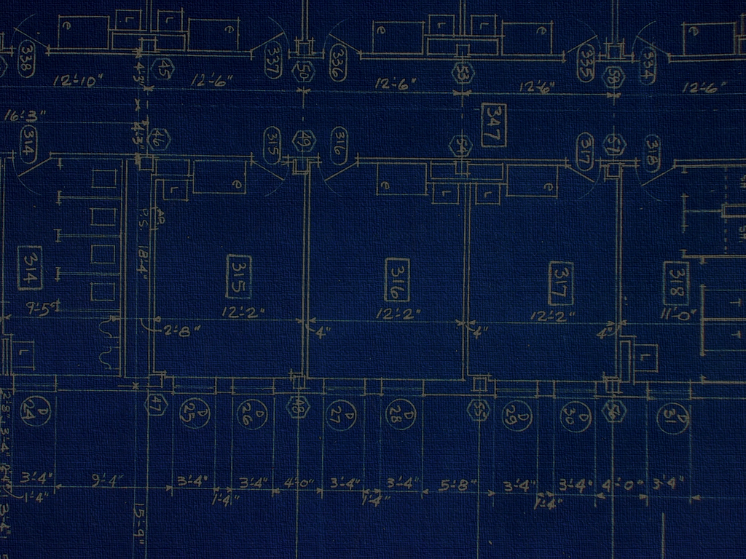
Microsoft ecosystem example
TFS
Commit
Change
TFS
App Code
ARM Templates
Azure DevTest
Deployment
Iff pass
Azure Stack Hub Prod Deployment

Slide 53
Heterogeneous ecosystem example
GitLab
Commit
Change
Jenkins
App Code
ARM Templates
Azure DevTest
Deployment
Iff pass
Azure Stack Hub Prod Deployment

Slide 54
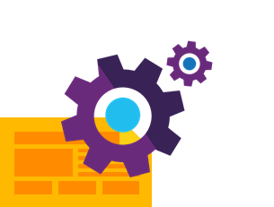

Infrastructure as code
Templates
Automation
Versioning

Slide 55


Infrastructure and configuration as code
DEV
Value
Optimized resources
Accelerated delivery
CODE
STAGE
Measure
Deployment rate
MTTR
DEV
OPS
PRODUCTION

Slide 56

Automated testing of infrastructure
Testing software
Value
Accelerate delivery
Repeatability
Optimized resources
X
Measure
Release frequency
MTTR
MTTD
DEV
OPS

Slide 57

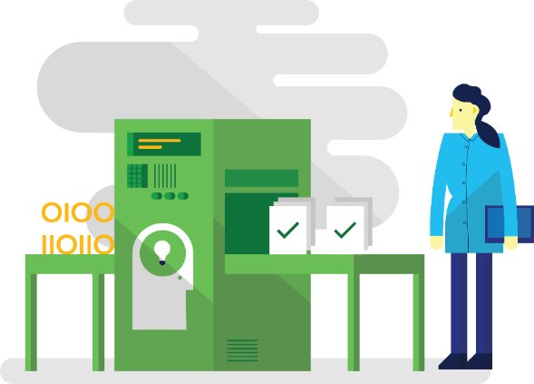

Hypothesis-driven development
Testing in production
Telemetry
Fault injection
PRODUCTION A
PRODUCTION B
PRODUCTION
X
90%
10%
X
X
X

Slide 58
User telemetry
SOURCE REPO
TELEMETRY SERVICE
Value
User engagement
Focus future app investment
Measures
Increased user activity
Increased access of features
Increased usage
PRODUCTION
DEV
OPS

Slide 59

Application performance monitoring
MONITORING
SERVICE
Value
Faster detection and remediation
Optimized resources
More resilience
PRODUCTION
Measures
Lower MTTD of failures
Lower MTTR of failures
Higher availability

Slide 60

Fault injection
Alert
Value
App resilience
Faster detection and remediation
INFO
PRODUCTION
X
X
X
X
Measures
Lower MTTR
Increased availability
Increased detection of issues
DEV
OPS
Logs

Slide 61
Testing in production
Value
Experimentation
More resilience
Accelerate delivery
PRODUCTION A
90%
Measures
Lower deployment rate
Lower MTTR
Increased availability
Change lead time
PRODUCTION B
DEV
OPS
10%

Slide 62
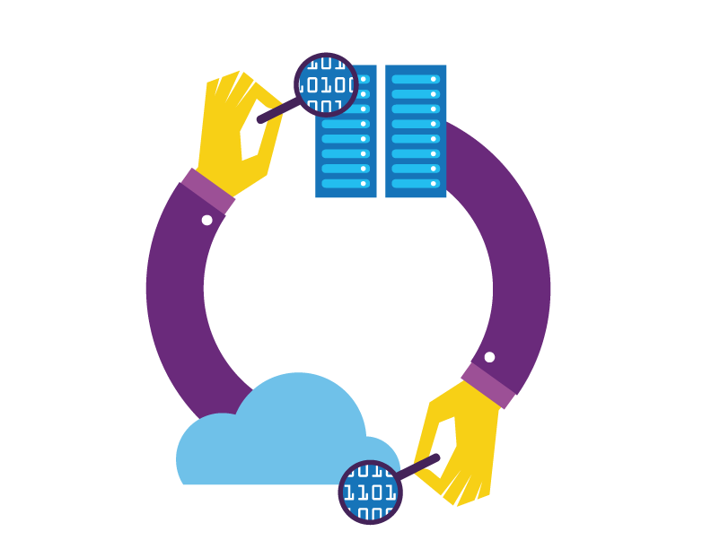
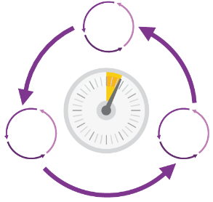
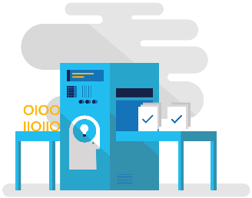
Eliminating waste
Reducing procurement cycle times and dependencies
Automation and self-service provisioning

Slide 63

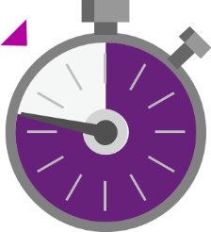

DevOps metrics
Deployment frequency
Change lead time
Change fail rate
Mean time to detect and repair
Agility performance indicators
Reliability performance indicators

Slide 64
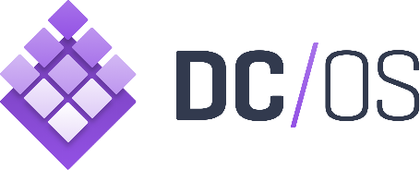












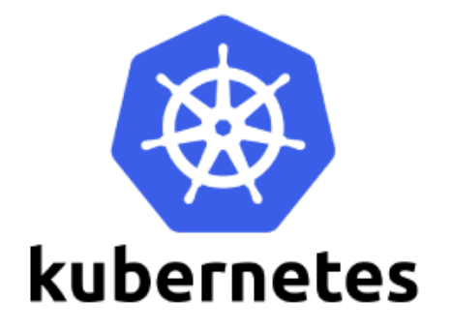
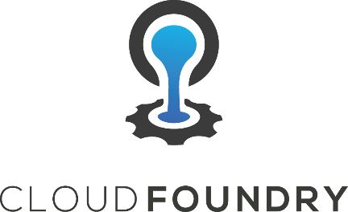

One Azure ecosystem
Work with the tools and technologies you want across Azure and Azure Stack Hub
Goal: Applications and services that are certified for Azure work on Azure Stack Hub

